Slide 1
PROJECT SEMINAR PHASE 2
Retinal vessel SEGMENTATION using
Matched filter
Guided by –
R Manjunath

Slide 2
Preprocessing: It involves processes like resizing the image and applying the basic label functions. Code used :P = imresize(I, [384 365]) img = im2double(P)

Slide 3
Label function: label matrix takes each connected component, that is for each region of ON pixels, in a binary image and assigns it a unique integer “label”

Slide 4
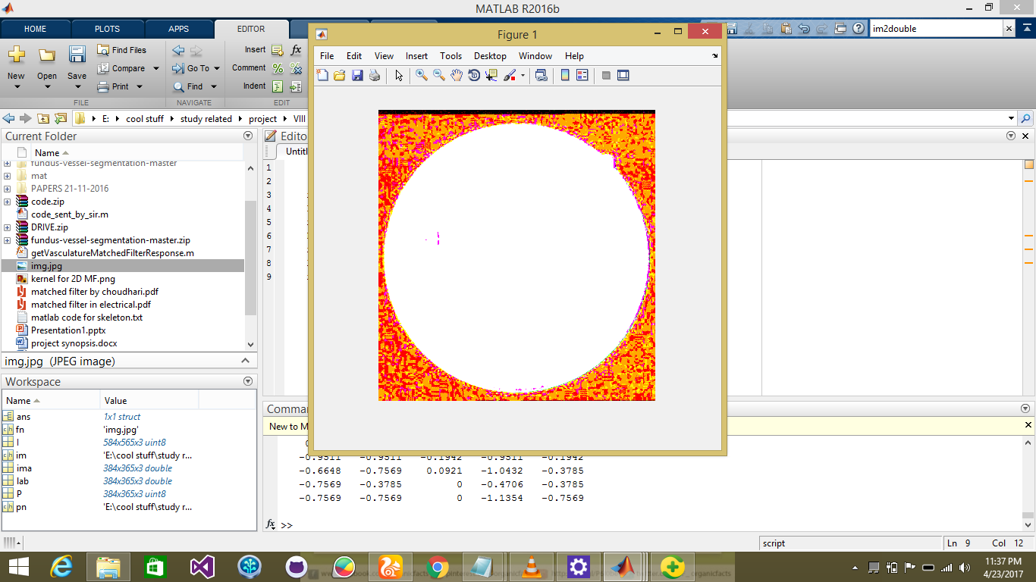
First output using label function:

Slide 5
We now form & study the histogram of the image for image improvisation. Code used : imhist(ima2gray) histo=adapthisteq(ima2gray,'clipLimit',0.05,'Distribution','rayleigh'); %imtool(histo) %imtool(ima2gray)

Slide 6
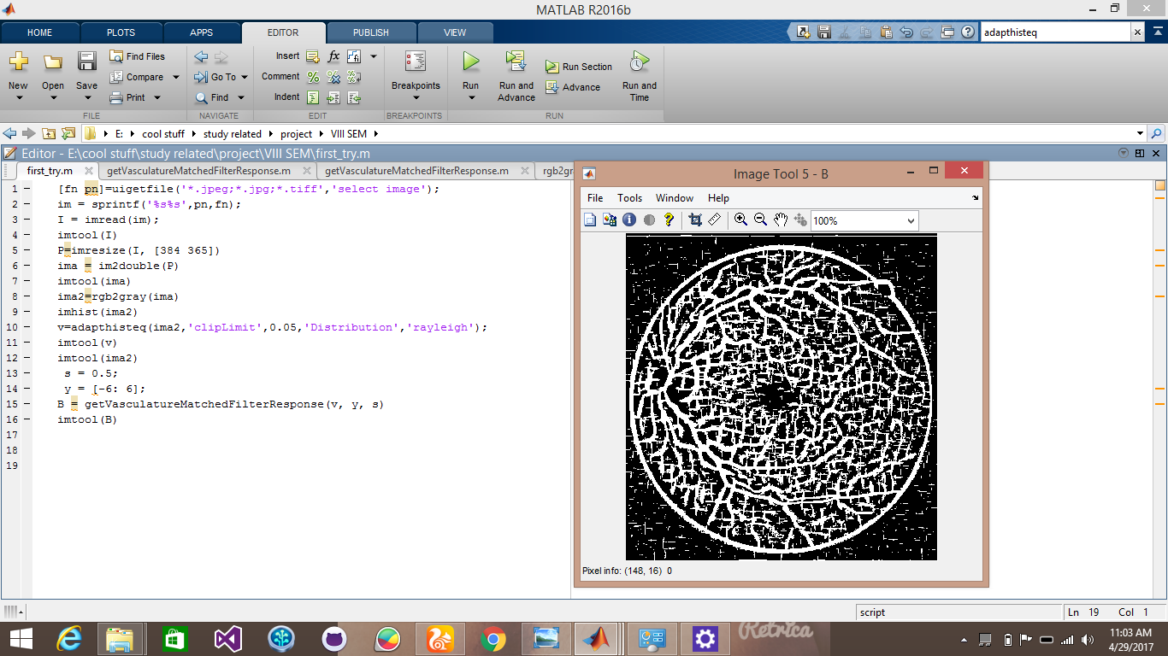
Image Improvisation: It involves conversion from RGB to greyscale image. code used : the segmented output
ima2gray=rgb2gray(img)

Slide 7
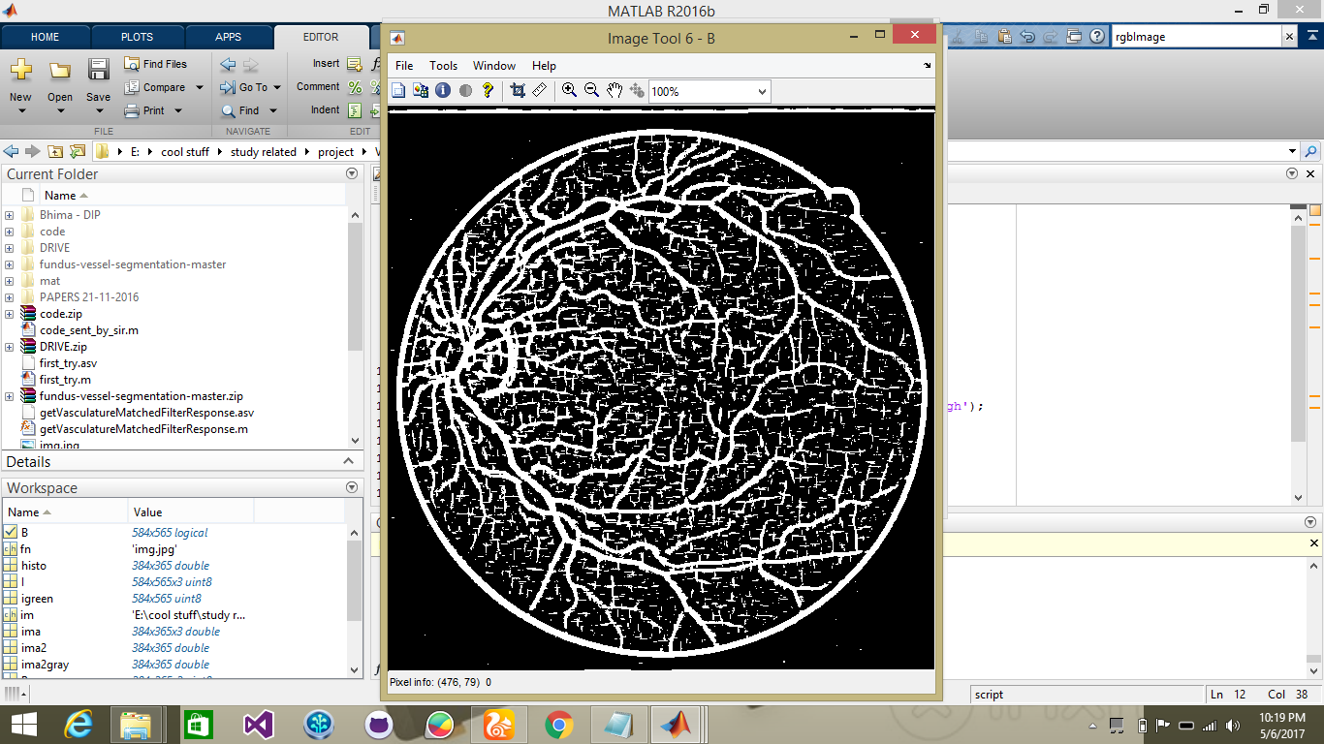
Xor operation b/w all 3 channels: It results in noise reduction and jitter removal. Now the vessel parts are better visible.

Slide 8
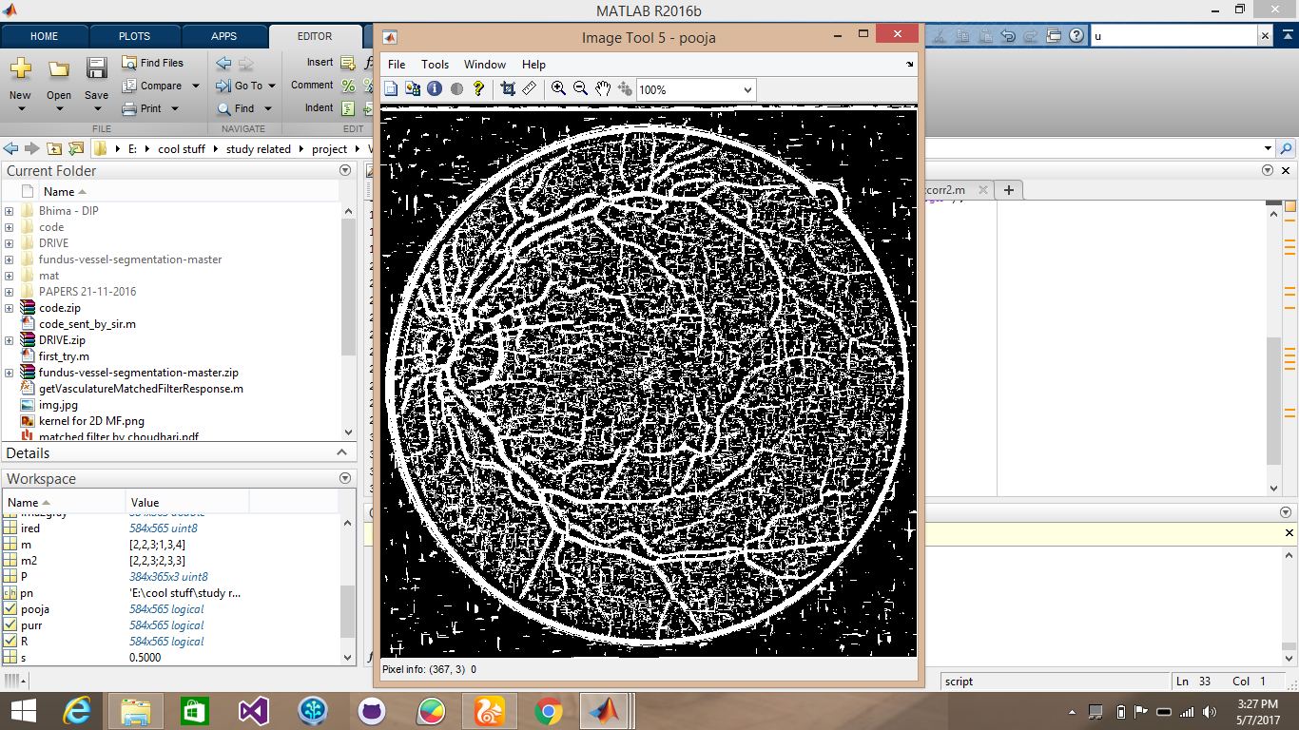
Now ,we apply xor between red and blue channels followed by an xnor operation with green channel.

Slide 9
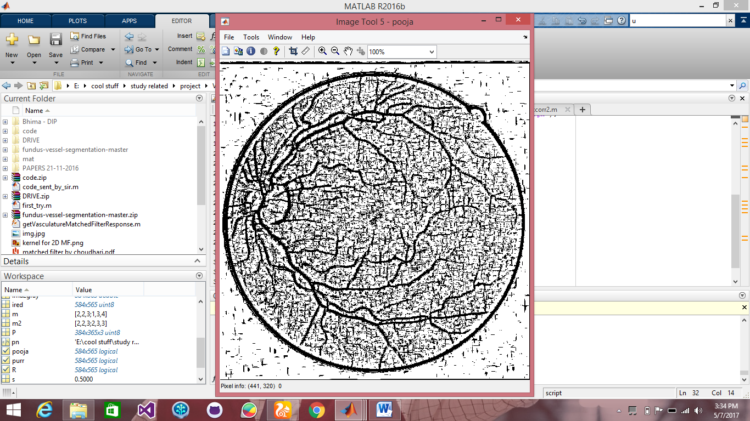
Final output image:

